Slide 1
Lecture no 02
THE FORMATION & EVOLUTION OF MUSLIM SOCIETY IN SUBCONTINENT

Slide 2
Factors which led Birth and Evolved Muslim Society in Subcontinent
Definition of Society:
A large group of people who live together in an organized way, making decisions about how to do things and sharing the work that needs to be done. All the people in a country, or in several similar countries, can be referred to as a society. (Cambridge)
A particular community of people who share the same customs, laws, etc. (Oxford)
Factors which led birth and evolved Muslim Society in Subcontinent:
Traders
Generals
Rulers
Sufis
Notes:
(Source: Keynoyer, “Ancient Cities of Indus Civilization”, Oxford University Press)

Slide 3
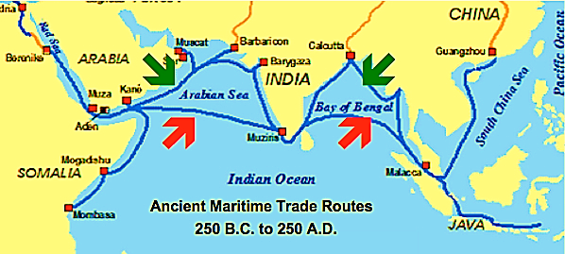
1- The Role of Muslim Traders for the Formation of Muslim Society in Subcontinent
Commercial links b/w Indian Subcontinent and Arabian Peninsula have been witnessed during Indus Civilization Period (3000-2000BCE).
Archeological sites of Indus Civilization and some ancient Arabian sites of Oman and Yemen, reveal the relations of Arabs & Indians during the Indus Civilization Period.
(Source: Keynoyer, “Ancient Cities of Indus Civilization”, Oxford University Press
Ancient Sea Route that Connected Indian Subcontinent with Arabian Peninsula
Notes:
(Source: Keynoyer, “Ancient Cities of Indus Civilization”, Oxford University Press)

Slide 4
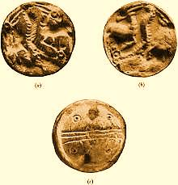
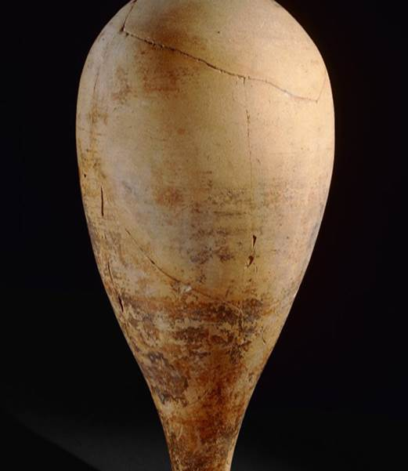
Black-Slipped Jar of Indus Civilization found from Oman
Circular Gulf Seals found from Lothal
(Indian side of Gujrat)

Slide 5
Arab-Indo Relations at the time of Advent of Islam
During Prophet’s (PBUH) time (610-632 CE), cultural and commercial interactions b/w Arabs & Indians were continued.
Sindhi tribes (Zoot/Jat, Maid, Asaawra, Biyasrah, Tahkur/Sodha, etc) were living in Arabian Peninsula.
Sindhi products (cloths, husbandry animals, iron, swords, wood, etc) were sold to Arabian markets.
The first Arab Army invaded Debul, Thana and Bharoch (the then Sindhi towns on Arabian Sea shore) during the reign of Hazrat Umar in 15 AH (636 CE). Later in 23 AH (644CE) Makran was conquered by Arabs.
During Hazrat Usman’s period (644-656), few famous Western Sindhi towns like Qindabel, Qeqan & Dawar were conquered.
Because of internal contradictions, Rashidun Caliphs (Hazrat Usman and Hazrat Ali) put their concentration to central affairs and the occupied parts in Subcontinent gradually revolted against Rashidun Governors.
Notes:
(Source: Athar Mubarakpur, “Arab O Hind: Ahd-e-Risalt Men”, & “Arab O Hind Ahd-e-Khilafat-e-Rashida Men”, Fikr o Nazar Publications Sukkur)

Slide 6
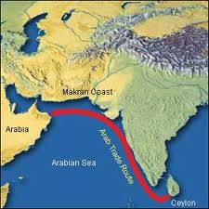
2. The Role of Generals in the Formation & Evolution of Muslim Society in Subcontinent
Muhammad Bin Qasim
Mehmud Ghaznavi
Shuhabuddin Ghauri and His Lieutenants
Commercial contacts b/w Arabia & Indian Subcontinent were continued. Ships of Arab merchants used to visit Subcontinent, even up to Ceylon (present Sri Lanka).
Walid bin Abdul Malik (705-715), the most famous Umayyad’s ruler, adopted an expansionist policy and tried to expand the territory of Umayyad’s Kingdom up to larger parts of Asia, Africa and even Europe.
Hajjaj Bin Yusuf (694-714), the most famous Governor of his period, took the charge of Viceroyalty of Iraq, Iran and other Eastern provinces, in 75AH/694CE, and the relations b/w Sindh & Arabs were now ready to be changed dramatically.
The Plundering of Arabian Ship at Debul by Sindhi pirates was the immediate reason for Arab Muslims to invade Sindh.
Notes:
(Source: Baladhri, Futuh-ul-Buladan, & Chachnama)

Slide 7
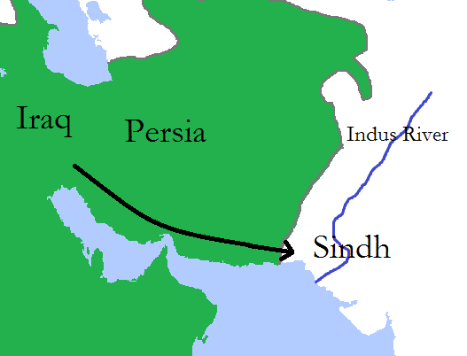
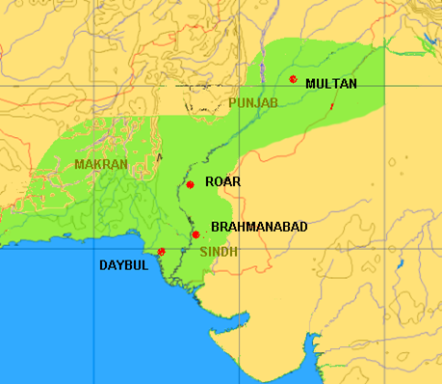
Conquest of Sindh (711-12 CE)
711CE: Ibn-e-Qasim’s huge Army enetered into Debul.
By 714CE, Nirun Kot, Sehwan, Brahmanabad and the capital Aror or Alor and Multan fell rapidly. Dahir was assassinated during battle of Brahmanabad.
In 714 Hajjaj died and next year Walid also died. He was succeeded by Suleiman bin Abdul Malik. Ibn-e-Qasim was removed and then arrested and died in Jail during torture.
In 750CE, Abbasids overthrew the Umayyads and now onwards Sindh came under control of Abbasids.
In 883-985CE, Rule of Hibbari Family of Arabs on Sindh, Mansura as capital.
883CE: 1st Ismaili missionary came into Sind.
977CE: Multan was captured by Ismailis.
1005CE: Mahmud Ghazni compelled ruler’s of Multan to abondon Ismaili doctrines.
1025CE: Mahmed Ghazni invaded Mansurah.

Slide 8
Impacts of Arab’s Rule on Sindh
Political & Administrative Impacts of Arabs on Sindh:
Adoption of policies of religious tolerance and patronage of Brahmins.
Military and State Affairs dealt by Arabs, civil administration by local persons.
Intellectual & Literary Impacts of Arabs on Sindh:
Sindh became the intellectual link b/w Indian learning and Arabs (Exchange of scholars’ visits, translations of local books into Arabic)
Mathematics and Medicines were shifted from Sindh to Arab.
Ismaili Shia as well as Sufi influences (Hallaj’s Arrival in Sindh)
Social and Cultural Impact of Arabs on Sindh:
Arabic left its impacts on local languages. (Script, Vocab, idioms, etc)
The outlook as well as living style (dressing, architecture, food, etc) of local people influenced from Arabs.
(Sources: Annemarie Schimmel’ Islam in Indian Subcontinent” & S. M. Ikram, “Muslim Civilization in India”)

Slide 9
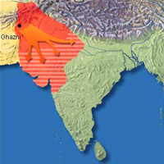
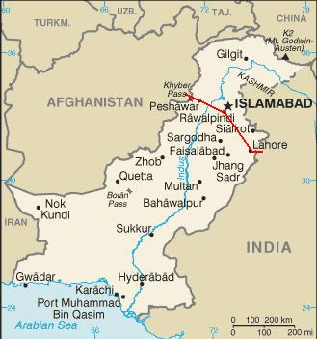
GHAZNAVIDS INVASIONS (977-1191 CE)
Impacts of Ghazni Period on Sub-continent:
2nd phase of Muslim rule expansion in subcontinent.
Arrival of Central Asian Muslims.
Enrichment of Lahore, literally (Mas’ud Sa’d Salman) and mystically (Data Ganj Bux).
Persian language and literature.
962, Alptigin laid the foundation of Ghazni Dynasty.
977-997 Subuktigeen’s Rule, son-in-law & successor of Alptigin.
980 AD, Subuktigeen attacked on the Jaypal, ruler of northern borders of India.
998-1030 AD, Mahmud Ghaznavi’s period.
1001-1026, Sultan Mahmood Ghaznavi carried out 17 expeditions in India.
Ghaznavid centres in Sub-continent, Lahore & Multan. Punjab was annexed.

Slide 10
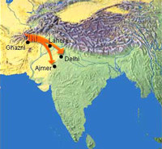
THE GHURI INVASIONS (1191-1206) THE CONQUEST OF NORTHERN INDIA
1196, Delhi was captured by Qutb-ul-Din Aibak.
Ikhtiyar ul din Khilji, the slave of Muhammad Ghuri conquered Bengal with only 18 soldiers.
1206 AD, Sultan Ghauri assassinated by an Ismaili.
1192, Hazrat Khwaja Moin-ul-Deen Chishti Ajmeri RA (d 1235 AD) arrived in India. He introduced the Chishti Order in Lahore (Punjab) and Ajmer (Rajasthan), sometime in the middle of the 12th century CE.
1173, Ghuri became the ruler of Ghazni.
1175-76, Multan and Uch were captured by Ghuri from Caramitians.
1179, Peshawar captured.
1186, defeated Khusrau Malik, last Ghaznavid emperor of Lahore and thus Lahore captured.
1191-1192: Two Battles of Tarrain against Prithvi Raj. First defeated & 2nd won. End of Rajputs supremacy and foundation of Muslim Rule in the sub-continent.

Slide 11
3- The Role of Muslim Rulers
4- The Role of Sufis
Delhi Sultanate Period (1206-1526)
The five Delhi based kingdoms or sultanates mostly of Turkic and Pashtun (Afghan) origin in mediaeval India.
The five dynasties were:
1. Mamluk/Slave dynasty (1206–90),
2. Khilji dynasty (1290-1320),
3. Tughlaq dynasty (1320–1414),
4. Sayyid dynasty (1414-51),
5. Afghan Lodi dynasty (1451–1526).
Mughal Empire (1526-1857)
Soomra and Samaa Dynasties of Sindh
Role:
1. Islamic Law was enforced by state.
2. Conversion was encouraged.
3. Ulemas and Sufis were patronized.
Shaikh Ali Hujweri of Lahore Chishti Order:
Chishti sufis of Delhi:
Khwaja Qutub-ul-Deen Bakhtiar Kaaki (1173 - 1235 AD), Khwaja Nizam-ul-Deen Aulia (1238-1325 AD).
Chishti & Suharwardi Sufis of Punjab: Baba Fareed Ganj Shakar of Pak Patan (d 1265 AD), the 1st Punjabi poet.
Suharwardi Order:
Shaikh Bahau-ul-Deen Zakariya Multani (1172-1262 AD).
Qalandar Lal Shbaz (d 1274 AD) arrived in Sehwan in 1251.
Naqshbandi Order:
Khwaja Baqibillah
Shaikh Ahmed Sirhindi (d.1624)

Slide 12
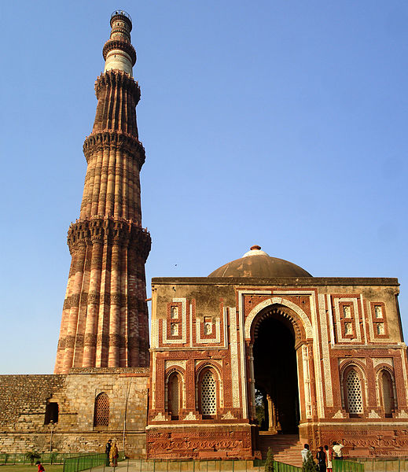
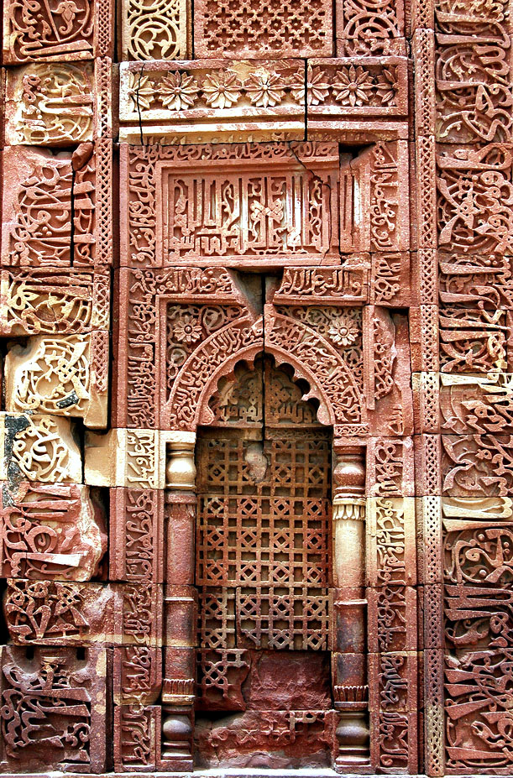
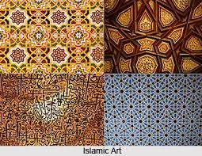
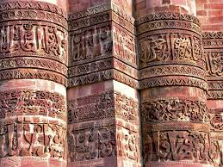
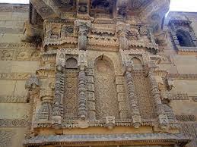
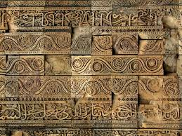
Muslim Architecture in India During Delhi Sultanate Period

Slide 13
Suggested Readings
Chachnama, Sindhi Adabi Board (Urdu, Sindhi Translations)
Biladhri, “Futuh –ul- Buladan” (Urdu & English Translations)
S. M. Ikram, “History of Muslim Civilization in India & Pakistan”, Institute of Islamic Culture
S.M.Ikram, “Aab-e-Kausar”, Idara Saqafat-e-Islamia
Annemarie Schimmel, “Islam in the Indian Subcontinent”, Sang-e-Meel Publications
Qazi Athar Mubarakpuri, “Arab Wa Hind Ahd-e-Risalat Men”, “Arab Wa Hind Ahd-e-Khilafat-e-Rashida Men”, “Arab O Hind Ahd-e-Khilafat-e-Umawi Men”, “Arab Wa Hind Ahd-e-Khilafat-e-Abasiyyah Men”, “Hind Men Arab Hukumaten”
Syed Suleman Nadwi, “Arab O Hind k Taluqat”, Mashal Books Publishers
Dr. Mubarak Ali, “Sindh Khamshi Ki Awaz”
Jonathan Mark Kenoyer, “Ancient Cities of Indus Civilization”, Oxford University Press
Dr. Irfan Habib, “People’s History of India: Volume II-Indus Civilization”, Fiction Book House

